Slide 1
OVULATION INDUCTION
Dr.Anitha. M
Associate Professor
S A T Hospital
Trivandrum

Slide 2
Ovarian stimulation aims at the development of one or more ovarian follicles to reach the stage of maturity culminating in the release of one or more mature oocytes ready for fertilization.
Ovulation Induction – mono ovulation.
Controlled Ovarian Hyperstimulation – multifollicular development.

Slide 3
What are the objectives of ovulation induction?
To induce monofollicular development and ovulation in anovulatory infertile women
To augment ovulation in unexplained infertility
For controlled ovarian hyperstimulation (COH) in IUI and ART

Slide 4
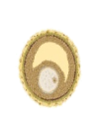
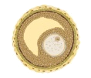
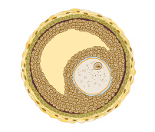
Duration of FSH secretion limited by negative feedback from estrogen produced by larger follicles
Smaller follicles with fewer FSH receptors no longer stimulated to grow by decreasing FSH levels undergo atresia
Therefore a single follicle reaches maturation stage
reduced stimulation
FSH
negative feedback
estrogen
atresia
mature follicle
Mono follicular ovulation
Notes:
4

Slide 5
FSH stimulates granulosa cell proliferation and aromatase production
LH stimulates androstenedione production by theca cells that diffuses into granulosa cells
Aromatase converts androstenedione into estrogen
FSH
granulosa cells
aromatase
estrogen
androstenedione
theca cells
LH
Notes:
5

Slide 6
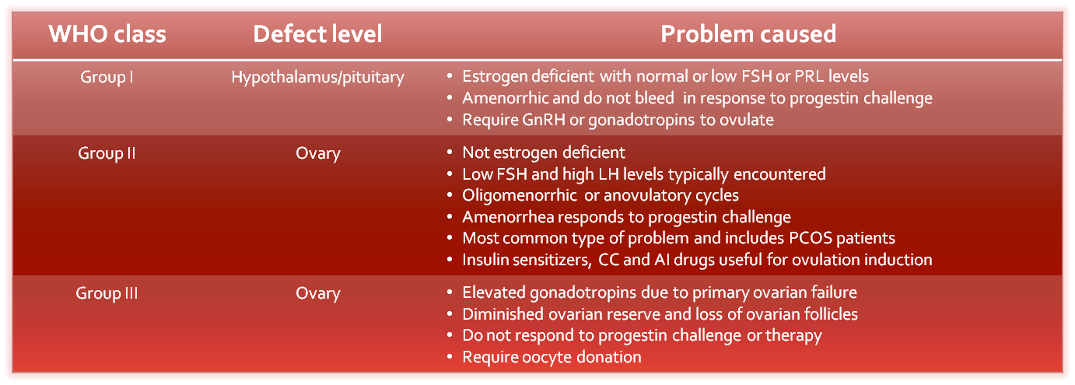

Slide 7
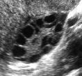
Prevalence of PCOS
Polycystic ovaries are present in
5-7% of women worldwide.
PCOS with anovulation constitute 60-85% of WHO group II women who would benefit from OI therapy

Slide 8
Life style interventions
Important in WHO 2 group –anovulatory.
Insulin resistance
Hyperandrogenism
Clinical
Biochemical
Obesity- 50% of PCOS have BMI >25 kg/m2
↑ miscarriage
Congenital abnormalities
Gestational diabetes / PIH
Still birth
Maternal mortality
Long term effects – DM , CVD

Slide 9
Benefits of weight reduction
Normalises endocrine mileu
Improvement of insulin sensitivity & hyperandrogenism.
Return of regular spontaneous ovulation
Pregnancy

Slide 10
All obese women with a BMI > 35 kg/m2 , seeking pregnancy should be denied any form of fertility treatment , until limited- at least 5 -10 % weight reduction has been achieved.
Stop smoking – depletes follicles.
Diet restriction – reduction of glycaemic load
Exercise.

Slide 11
Mechanism of Ovarian Stimulation
Pharmacological agents.
Moderate and manipulate endogenous gonadotropins.
Oral agents.
Selective Oestrogen receptor modulators –SERMS.
Clomiphene citrate, Tamoxifen.
Modulate oestrogen production – Aromatase inhibitors.
Letrozole , Anastrazole.
Injectables.
Gonadotropins

Slide 12
Clomiphene citrate
First line drug for most anovulatory or oligo-ovulatory infertile women with adequate estrogen (WHO type II esp PCOS)
and a positive progesterone challenge test
Not for women with low E levels (WHO type I and III women)

Slide 13
Clomiphene Citrate
Greenblatt in 1962.
Long half life 5-21 days.
Stored in body fats.
Estrogen agonist and antagonist –SERM.
Agonist properties manifest only when endogenous oestrogen levels are very low.
Racemic mix of enclomiphene and Zuclomiphene.

Slide 14
Enclomiphene more potent antioestrogenic
Responsible for the ovulation stimulation
Half life of few days.
Zuclomiphene cleared more slowly.
Responsible for the peripheral action.

Slide 15
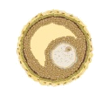
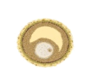
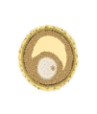
CC binds to ER and depletes receptor concentrations
1
Hypothalamus Pituitary
estrogen –ve feedback interrupted
2
3
FSH stimulation continues
4
More smaller follicles are rescued
5
Multiple follicles develop

Slide 16
Mechanism of action
Binds to estrogen receptors.
Bindings lasts upto weeks.
Depletes estrogen receptors.
Main site is hypothalamus, also the pituitary.
ER depletion interpreted as low levels.
Reduced negative feed back.
GnRH ↑, FSH /LH ↑
So intact HT-Pituitary axis & endogenous E must

Slide 17
Why the peripheral antiestrogenic effects?
CC has a long half-life of days upto 7 weeks.
Prolonged ER depletion
This results in prolonged increase of FSH Supraphysiological levels of E
All this causes the antiestrogenic effects in the endometrium
Extension of the FSH window leads to multiple ovulation and increased multiple pregnancy

Slide 18
Dosage
50 mg daily D 2 – D 5.
Increments of 50 mg.
Dose ranging from 50 – 250 mg/day.
No indication to further ↑dose ,once ovulation achieved.
Higher doses do not improve pregnancy rates.
Failure to respond to 150 mg will require alternative treatments.
Pregnancy rates increased in the first 3 cycles.
Beyond 6 cycles , not recommended. (BFS) / 12 m (RCOG)

Slide 19
Results of accelerated dose and extended dose has not been found to be effective.

Slide 20
Follicular monitoring
Baseline scan on day 2
Start monitoring on day 7 – 10
Pre ovulatory follicle 17 to 25 mm
Endometrial thickness at least 7 mm triple line appearance

Slide 21
Efficacy of Clomiphene
Clomiphene induces ovulation in 60-80% of well selected cases
More than 70% will ovulate at the 50 -100 mg doses
However, pregnancy rate is only 20- 40% Pregnancy rate / cycle is a mere 10-20%
Failure to conceive within 6 months of ovulatory cycles should warrant other investigations

Slide 22
Drawbacks of clomiphene
pituitary/hypothalamus
Induces ovulation
Anti-Estrogenic effects contributing to reduced pregnancy rates
clomiphene
Endometrial thickness < 5-6 mm
Reduction in glandular density
Increase in number of vacuolated cells
Decreased uterine blood flow during early luteal phase
isomers
endometrium
cervical mucus
Change in quantity or quality of mucus
Miscarriage rate of 26%
Notes:
22

Slide 23
Clomiphene – side effects
Multiple pregnancy 3% - 13%
Hyperstimulation 6%
Vasomotor flushes
Visual symptoms like blurring of vision
Breast tenderness
Persistence of follicular cysts
Abdominal discomfort

Slide 24
Question of whether treatment with ovulation induction drugs increases risk of ovarian tumours or cancer remains unsettled,but cannot be summarily dismissed.
Women who are offered ovulation induction should be informed that a possible association between ovulation induction therapy and ovarian cancer remains uncertain. Practitioners should confine the use of ovulation induction agents to the
lowest effective dose and duration of use.
Nice Fertility Guidelines; 2004

Slide 25
Adjuvants to clomiphene
Metformin
Bromocriptine or cabergoline in assoc hyperprolactinaemia
Thyroxine in assoc hypothyroidism
Dexona in the rare case of increased DHEAS levels
HCG for the LH surge

Slide 26
Clomiphene resistance & failures
CC resistance (CRA)
Failure to ovulate
Insulin resistance
Inappropriate indication
About 20-25% of anovulatory women are CC resistant
CC failures (CCF)
Ovulate , but fail to get pregnant
Underlying other factors
? Antioestrogenic effects
Notes:
26

Slide 27
Clomiphene resistance – how to manage?
CC+ gonadotrophins
Gonadotrophins
Lap ovarian puncture

Slide 28
Aromatase Inhibitors.
Aromatase enzyme catalyses the rate limiting step- the conversion of androgens to oestrogens.

Slide 29
Role of aromatase
Ovaries
Brain
Adipose tissue
Muscle
Liver
Breast tissue
Malignant breast cancers
androstenedione
estrone
testosterone
aromatase
estradiol
Casper RF and Mitwally M, et al. Review: Aromatase inhibitors for ovulation induction. J Clin Endocrinol Metab, 2006; 91: 760-771
Notes:
29

Slide 30
Pharmacokinetics
Rapidly absorbed bioavailability 99.9%
Widely dist in all tissues esp brain
Metabolised and eliminated in liver rapidly
Half life is very short (about 50 hours)

Slide 31
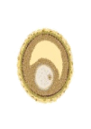
Comp and reversibly binds to haem subunit of aromatase
Inhibits aromatase in ovaries and peripheral tissues reducing estrogen levels
Negative feed back being active stimulates hypothalamus-pituitary axis
GnRH release produces FSH
FSH-mediated stimulation of follicle
Rising estrogen level from follicle suppresses FSH leaving a single dominant-follicle
Normal FSH window
Physiological levels of E
3
-ve feedback stimulation
4
GnRH released
Hypothalamus Pituitary
FSH stimulation
5
Falling FSH
estrogen –ve feedback
2
Smaller follicles undergo atresia
1
6
Single follicle develop
androstenedione
↓ estrogen
aromatase inhibition
Notes:
31

Slide 32
Peripheral actions
Androgen accumulate in follicle stimulates FSH receptors and IGF-1 which promote folliculogenesis.
Low E levels results in up regulation of ER in the endometrium and increasing sensitivity to subsequent E and thereby normal endometrial development

Slide 33
Dose of letrozole
Dosage is 2.5 -5 mg daily from day 3 for 5 days
Side effects very mild (GIT related) and seldom necessitate discontinuation

Slide 34
Clomiphene & Letrozole
Long half life Mechanism is receptor blockade Antiestrogenic effects Supraphysiological levels of E detrimental to embryos Receptors are depleted in the endometrium and so poor endometrial response may impair implantation More chance of miscarriage | Short half life (only 2 days) Mechanism is aromatase inhibition No such effects Physiological levels of E No effect on receptors ER are upregulated and endo response is good Less chance

Slide 35
Letrozole along with gonadotrophins in COH

Slide 36
Notes:
36

Slide 37
Letrozole plus gonadotrophins
Significant reduction in FSH dose
Less antiestrogenic effects compared with clomiphene
Pregnancy rates equivalent to FSH alone and twice that with FSH and clomiphene
Marked reduction in cost
May improve response to FSH in poor responders

Slide 38
What is the place of aromatase inhibitors?
Ovulation induction in clomiphene resistance and failures in PCOS and unexplained infertility
As an alternative to clomiphene
Along with FSH for COH for IUI
In poor responders of FSH
ART?

Slide 39
Ovarian stimulation by aromatase inhibitors is associated with significantly lower oestrogen production per follicle, hence overall lower E levels.
Certain groups are definitely benefitted by this
Women with oestrogen dependent disorders like endometriosis or breast cancer, or those with inherent clotting abnormality.

Slide 40
Gonadotropins
CRA / CCF
HMG / HP HMG / Recombinant FSH
Direct stimulation of the follicular growth.
Step up / Step down protocol
Strict cancellation criteria - >3 follicles 12 mm
Ovulation 82%
Pregnancy 58%
Multiple pregnancy 11 – 44%

Slide 41
Gonadotrophins
Close monitoring
Usually step up protocols
Start with lowest dose in PCOS
TVS from day 7 and increased dose acc
Problems
Multiple pregnancy 20%
OHSS
Premature LH surge

Slide 42
Insulin sensitizers
Metformin – Biguanide
Restores endocrine mileu
Lowers insulin resistance
Lowers hyperandrogenism
Normalises ovarian response to FSH
Dose – 500 mg 2-3 times daily
Not a first line drug / combination with CC not superior.
Second line in patients with CRA and BMI >35 and IGT
(ESHRE & ASRM)
Not licensed for OI
GI side effects – nausea , vomiting , diarrhea.

Slide 43
LEO
In CRA
Drilling small holes in the ovarian cortex – drains androgen rich fluid
Cumulative pregnancy rate, live birth rate , abortion rate comparable with gonadotropins
Multiple pregnancy rates lowered significantly.
Risk of surgery, accelerated decline of ovarian reserve.

Slide 44
To take home…..
In chronic anovulation, life style modification may be the first step.
Important to distinguish between WHO Type 1 and 2 anovulation.
Follow the traditional sequence for OI – CC followed by exogenous FSH.
Frequent monitoring and strict cancellation criteria will prevent serious complications like high order pregnancy and OHSS.
Enhancement of local circumstances,aiming to reduce hyperinsulinaemia and hyperandrogenism

Slide 45
CC for not more than 6 cycles.
Start with lowest dose , accelerate only when required.
Gonadotropins in CRA / CCF / COH .
Ovulation induction to be restricted to patients presenting with infertility and chronic anovulation and it should primarily aim at restoring physiology.

Slide 46
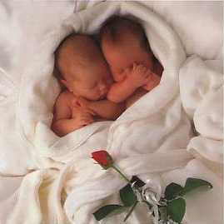
Thank you
A baby is God's opinion that the world should go on.-- Carl Sandburg

